Slide 1
BHSD STAR TREAT FIRST
BHSD Star Registration/ Update

Slide 2
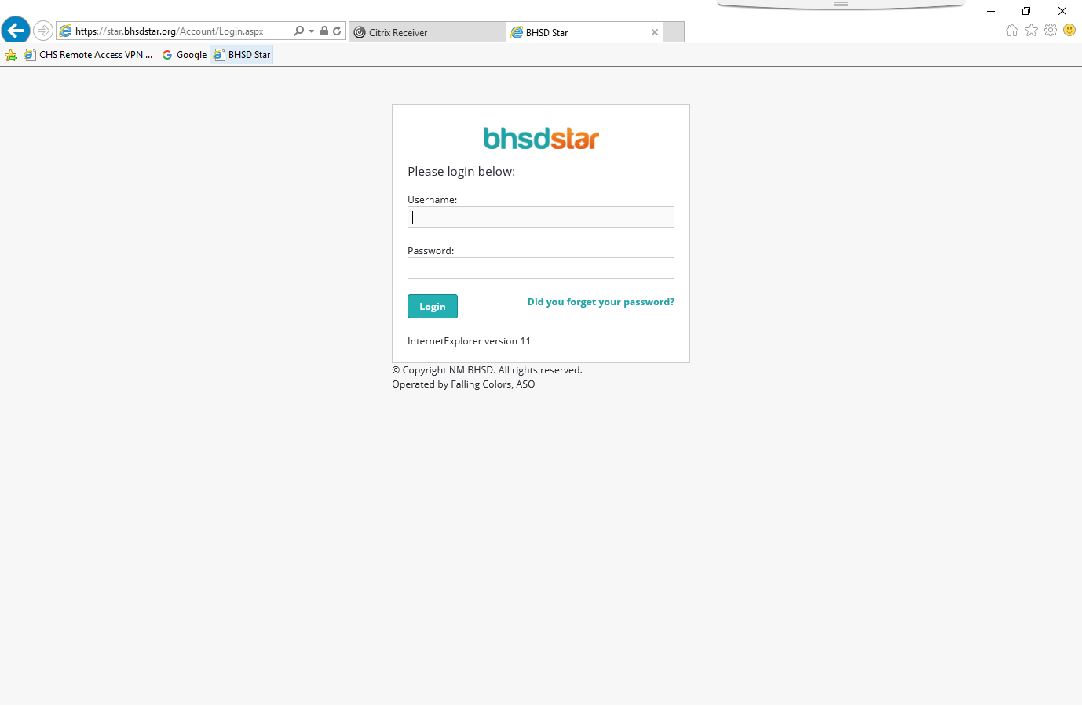
Enter your username and password given to you by your supervisor.

Slide 3
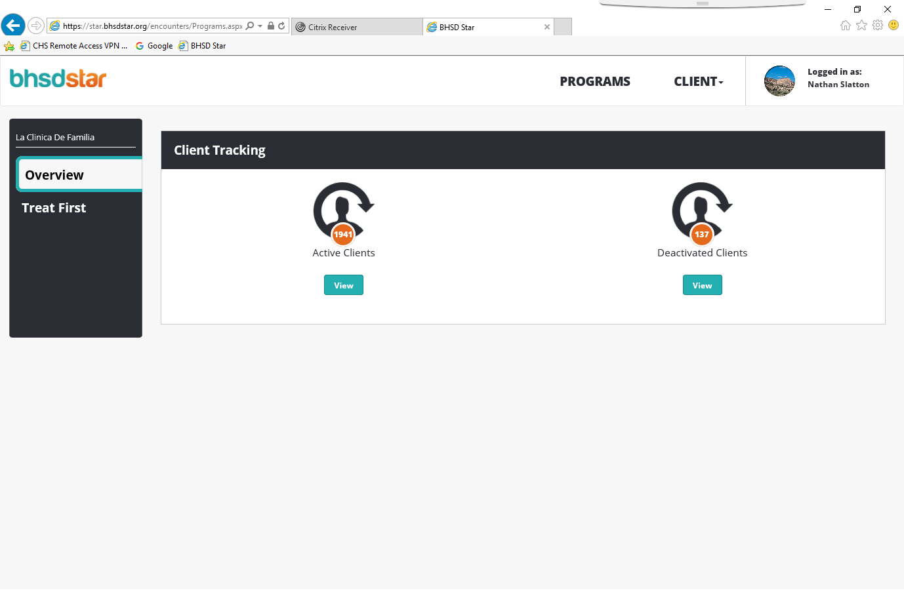
This is where you can select all active clients or all deactivated clients

Slide 4
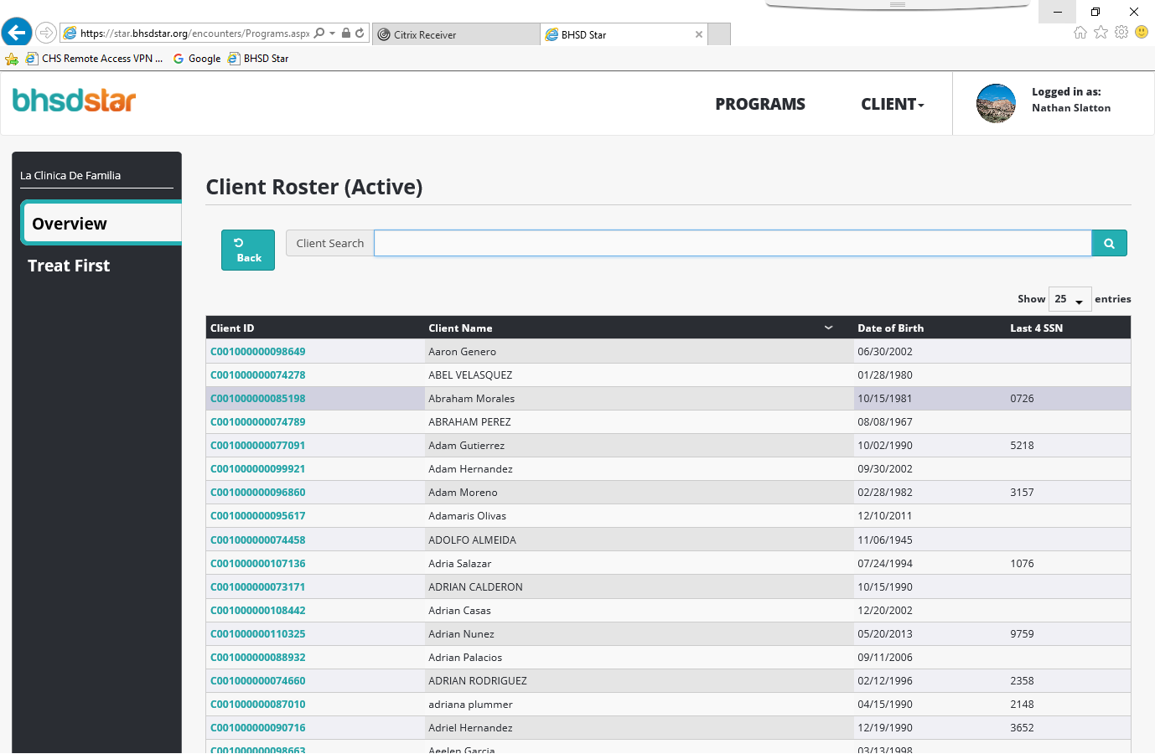
You can search for a client with the search box or scroll though
the clients to find the one you need.

Slide 5
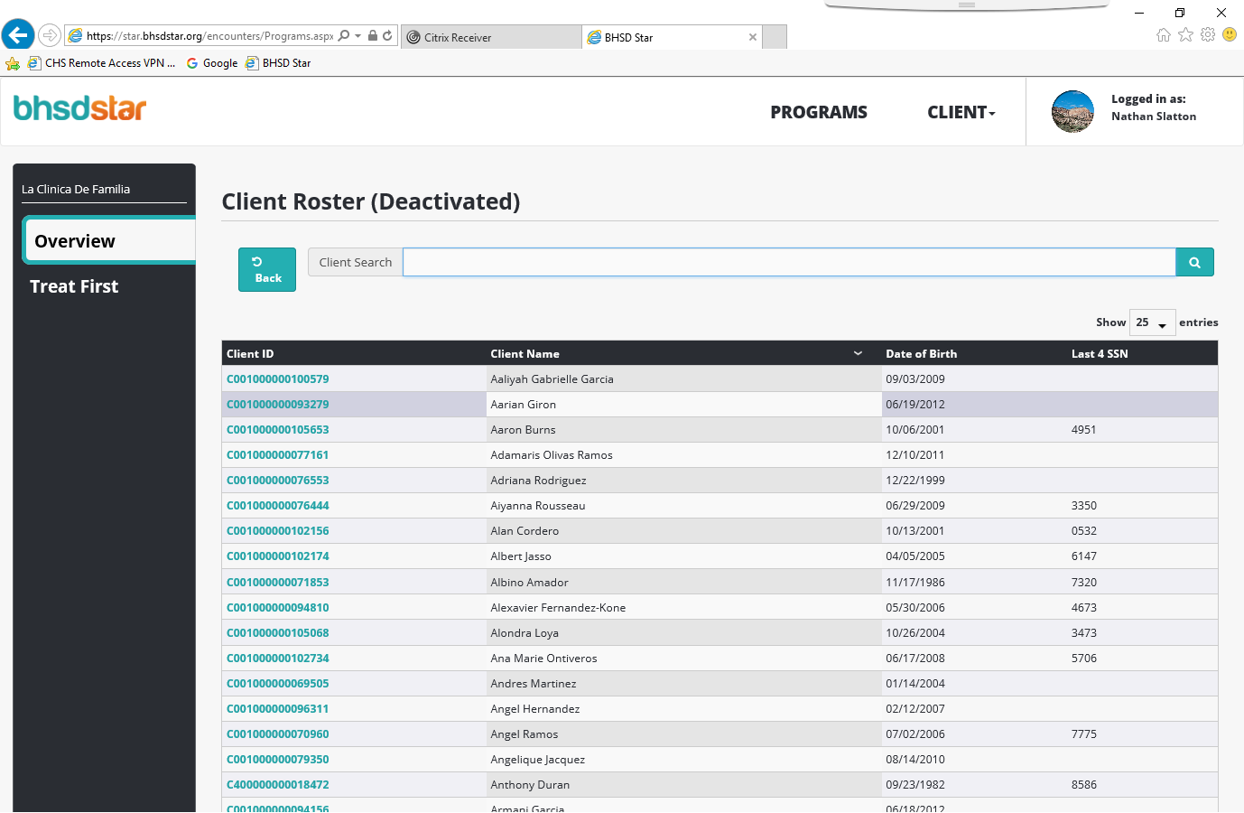
You can search for a client with the search box or scroll though
the clients to find the one you need.

Slide 6
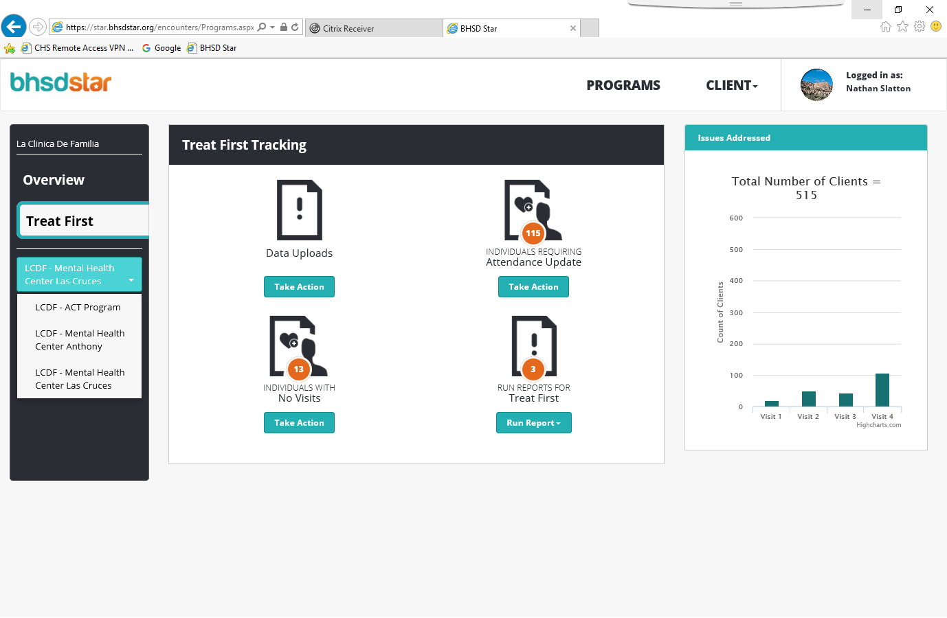
By selecting Treat First you can Upload client information, update attendance to an appointment,
add visits to previous registrations, or run reports.
You can also select the different programs you want to see.

Slide 7
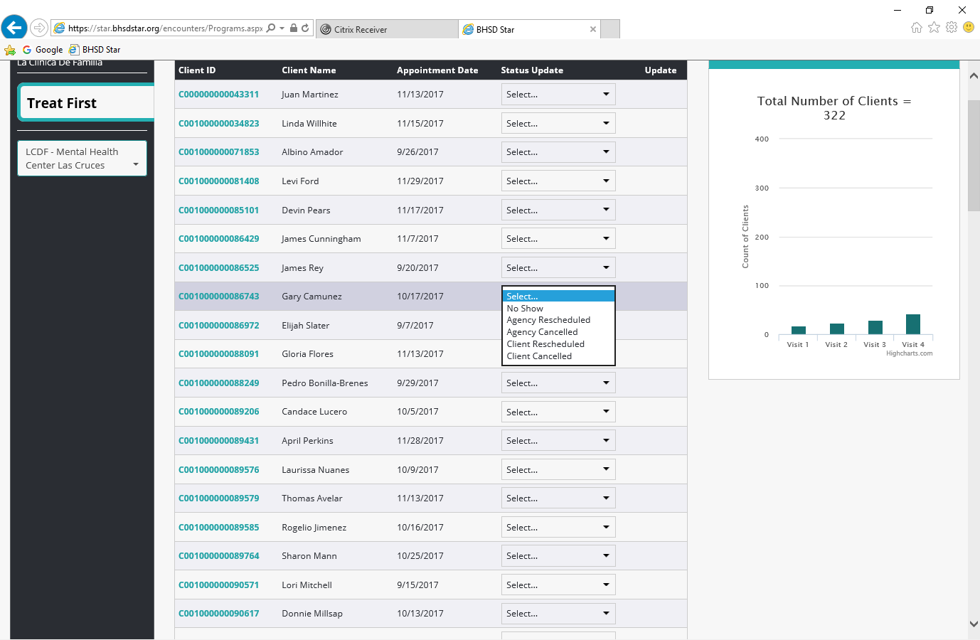
Individuals Requiring Attendance Update
Here you can select the alternate status of the appointment.
Just find your client and use the drop down box to select the option needed.

Slide 8
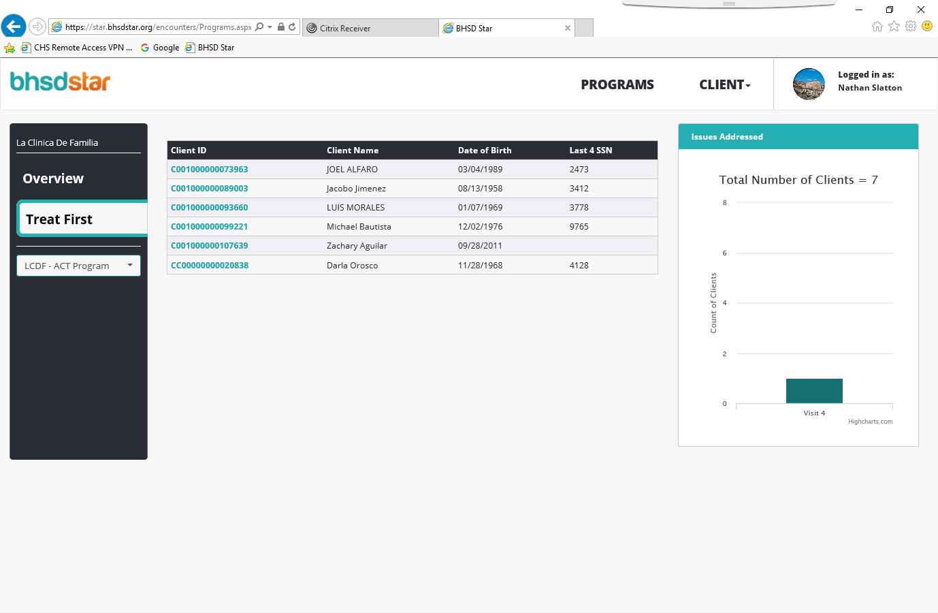
Individuals with No Visits Here you can continue Registrations/Updates for clients.
Select the client ID you are needing.

Slide 9
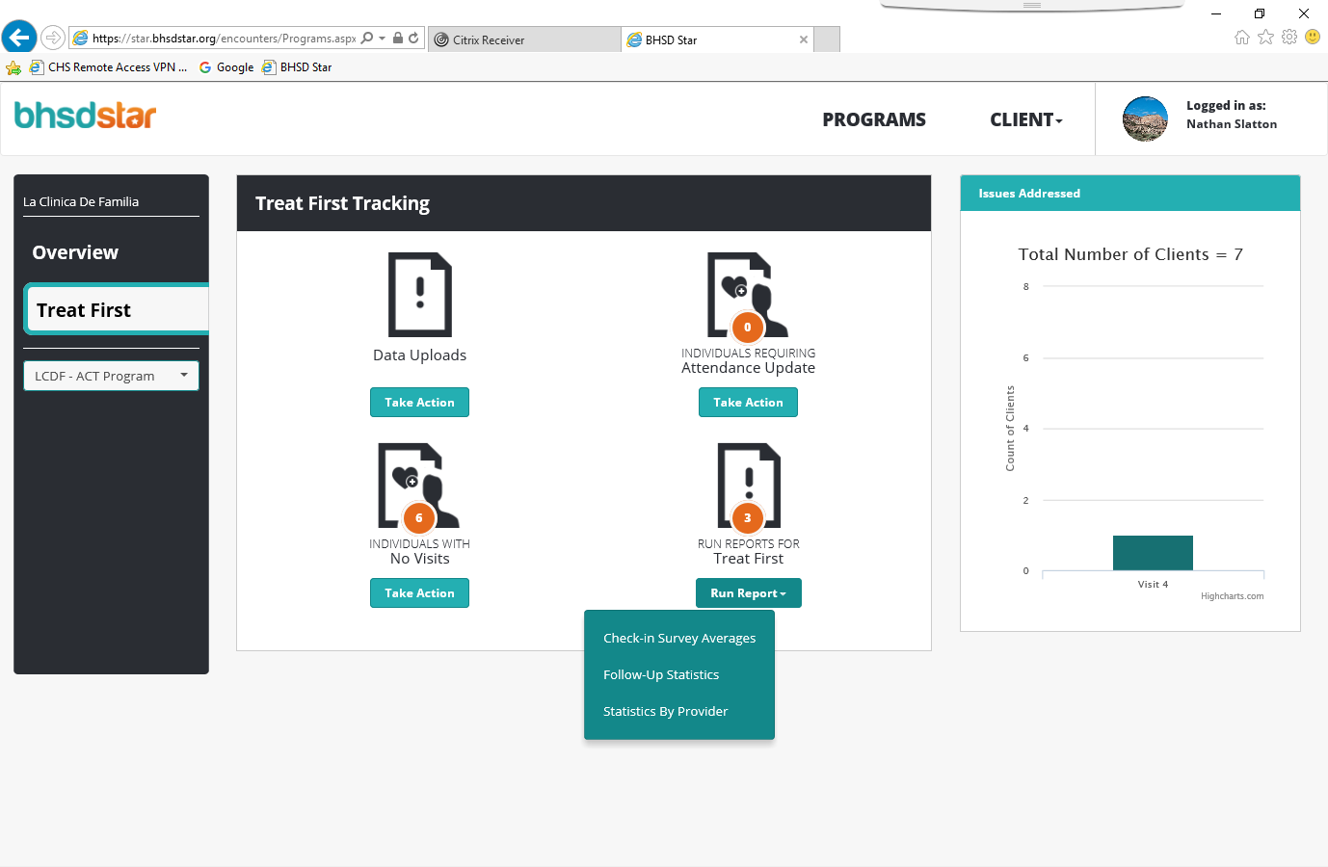
Run Reports for Treat First
This will primarily be used by supervisors or higher.

Slide 10
Profile:
The next slide will be an example of the profile that will needed to be filled out. This information can be found within your EHR or on the Registration paperwork filled out by your client.
Most information is required throughout the registration process. If you do not have the information and it is not required by the system you may leave it blank.
Remember to get the client’s ID number, Medicaid ID number, and Chart number from your EHR or Registration paperwork for this section.

Slide 11
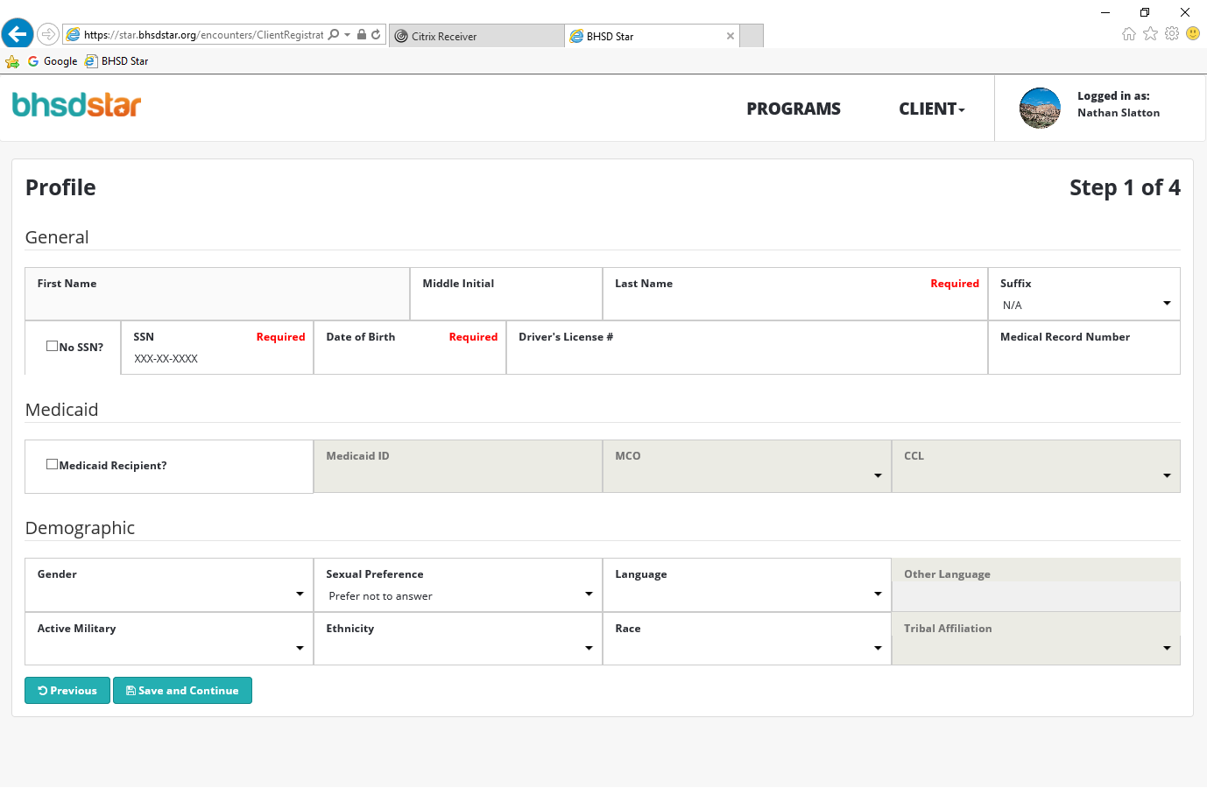

Slide 12
Address:
The next slide is an example of the address information needed for the registration process. This information can be found within your EHR or on a Registration sheet filled out by your client.
Most information is required throughout the registration process. If you do not have the information and it is not required by the system you may leave it blank.
Address line 2 is for mailing address that is different from their physical address.

Slide 13
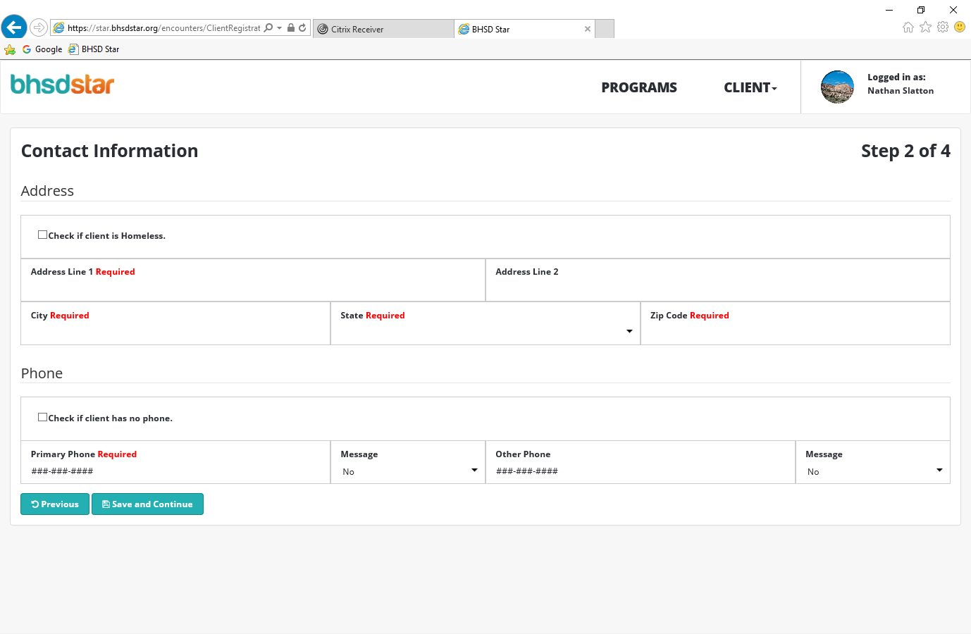

Slide 14
Contacts:
The next slide is an example of the contact information needed for the registration process. This information can be found within your EHR or on a Registration sheet filled out by your client.
Depending on what information you have available you may only have one you can fill out. If there is no contact information you can leave it blank.

Slide 15
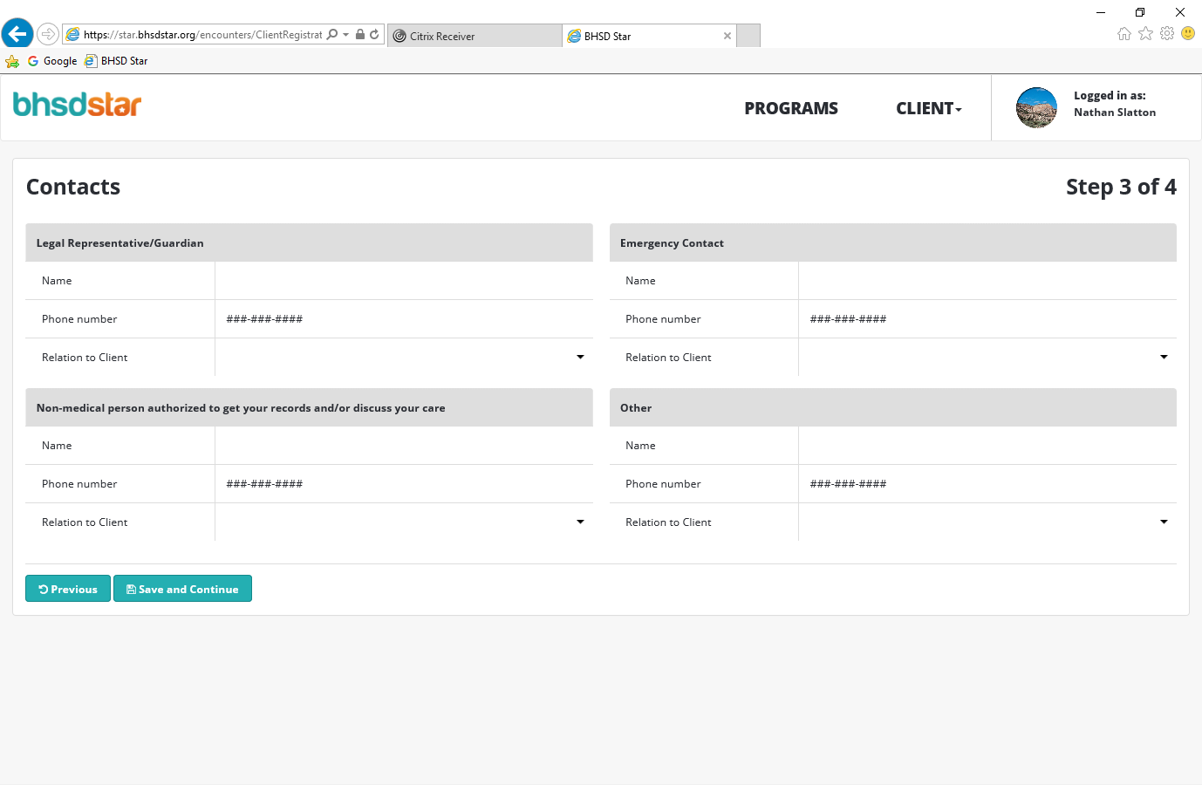

Slide 16
Initial Registration Data
The next two slides are examples of the Initial Registration Data needed for the registration process. This information can be found within your EHR or on a Registration sheet filled out by your client, some information may be found within other paperwork filled out by employees such as diagnosis and substance abuse information.

Slide 17
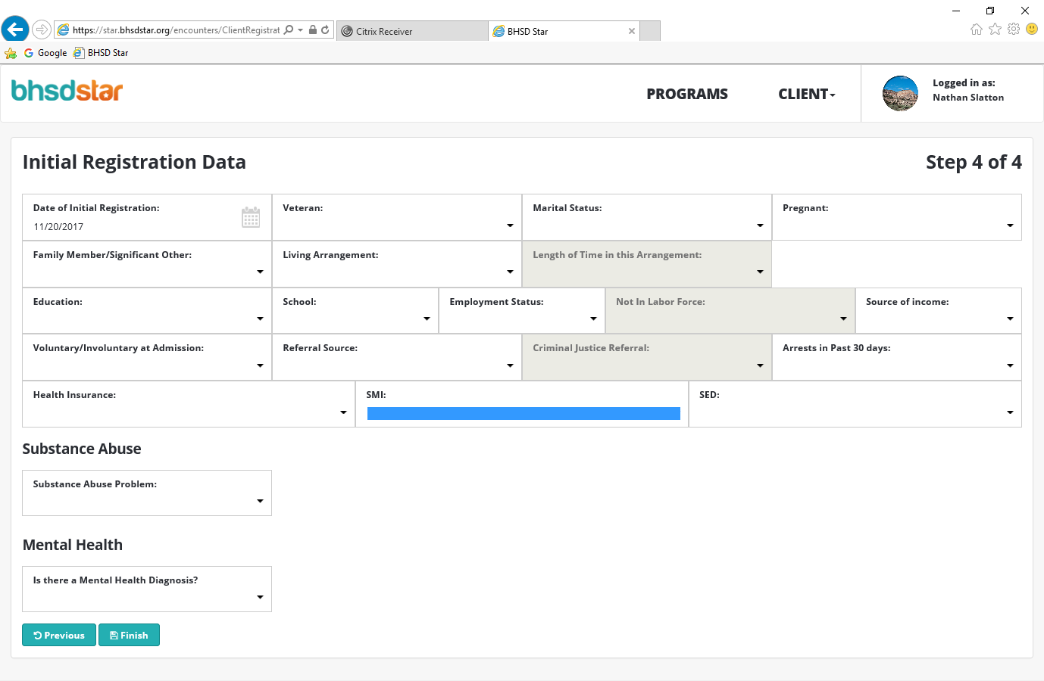

Slide 18
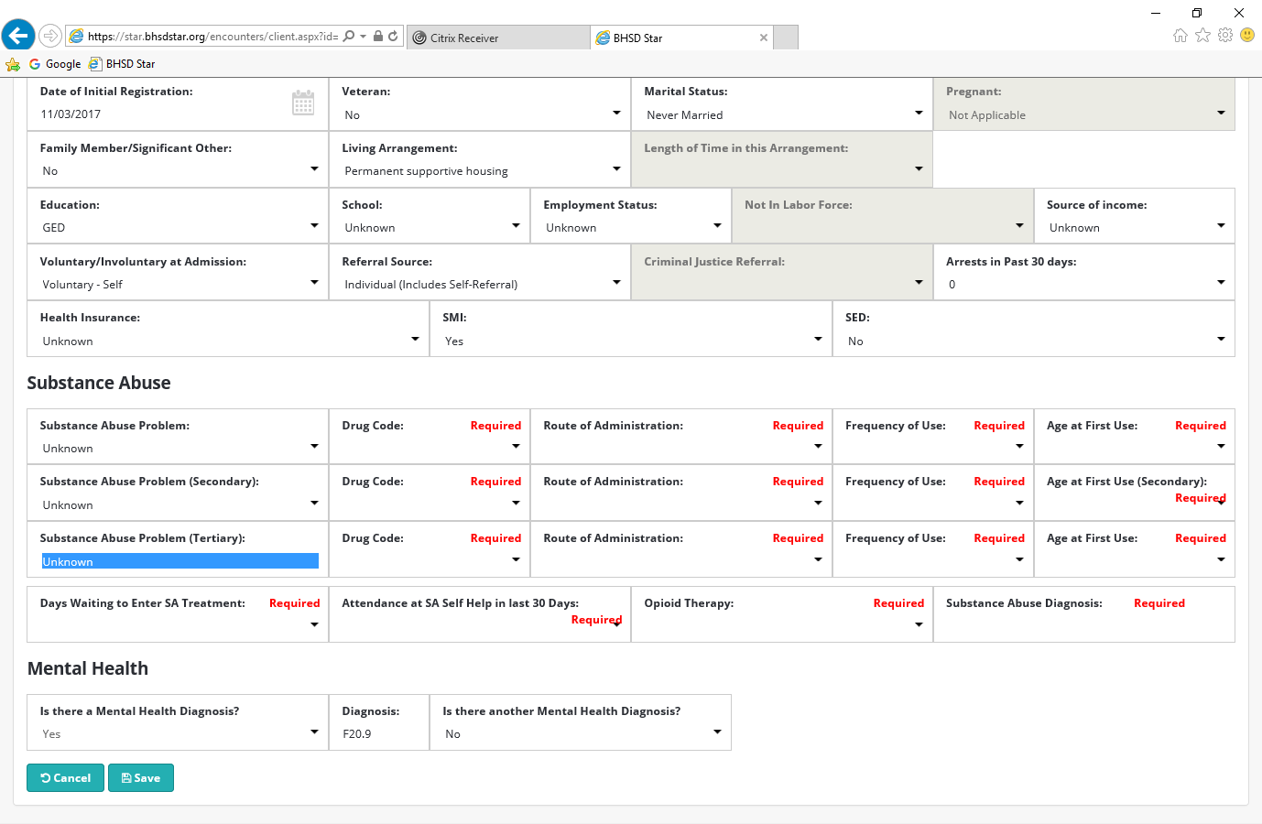

Slide 19
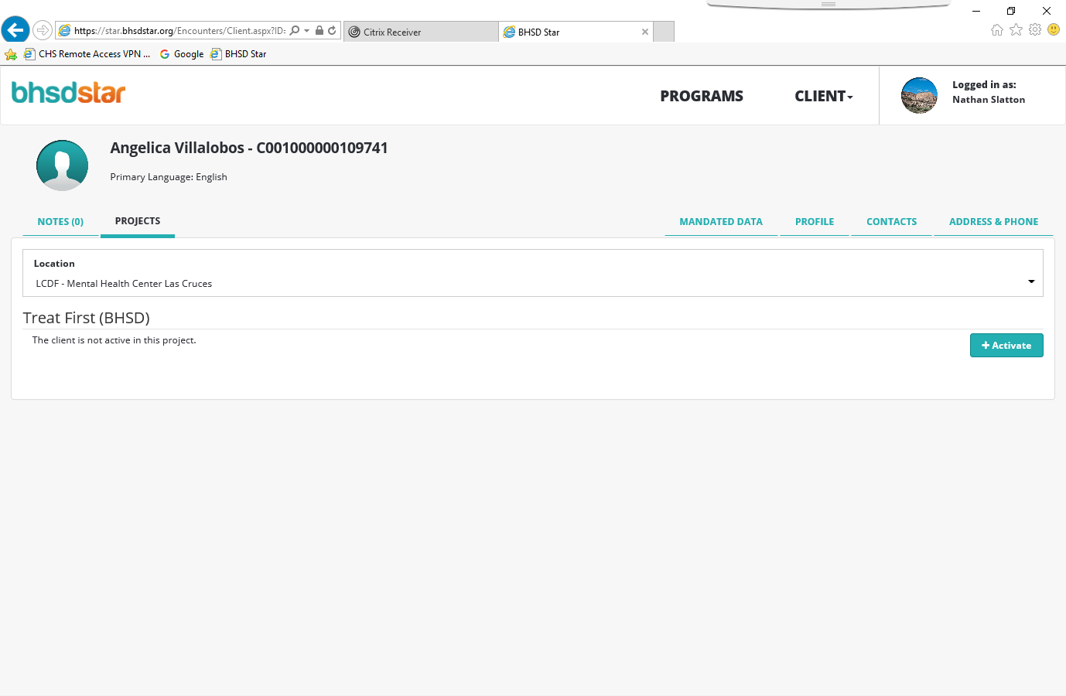
1
2
3
In this slide you will see an example of the Projects tab.
(1) After completing the registration process you will need to activate the account in the Projects tab.
(2) After selecting the projects tab you will need to select you location/ Program that this client will be apart of.
(3) Once you have selected the program select Activate.

Slide 20
Start New Visit
After you have activate the client in the correct program you will find a Treat First Visits tab added to the Notes and Projects tabs.
Select the tab and you will find the example in the next slide.
Select Start New Visit.

Slide 21
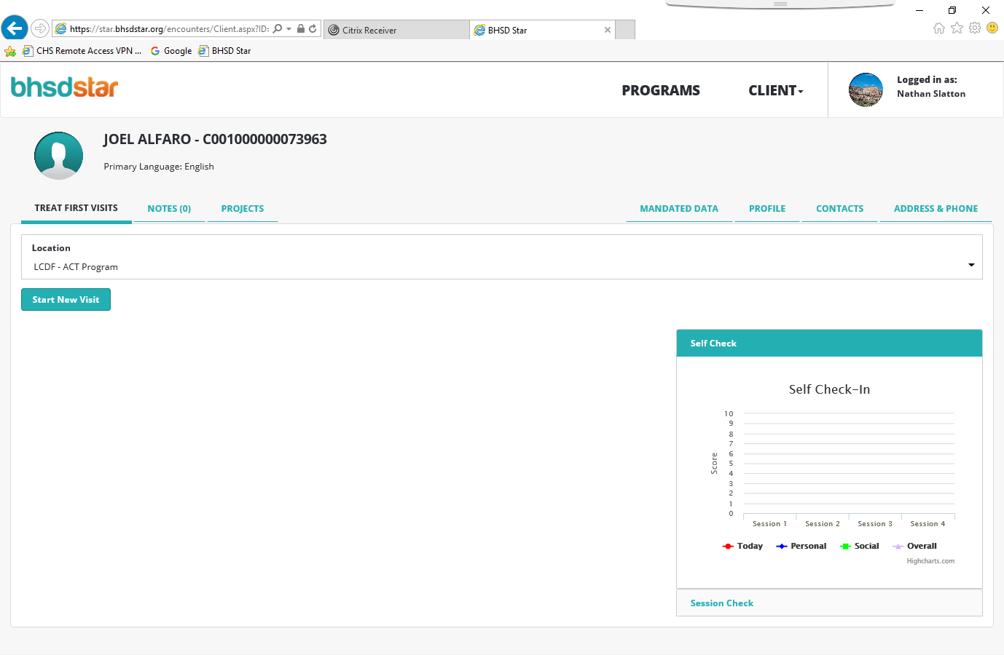

Slide 22
Self Check-in
The next slide is an example of the Self check-in portion of the Self Check-in/ Session check-in sheet that clients will NEED to do EVERY Treat First appointment.

Slide 23
To be filled out at the beginning of the appt.

Slide 24
Self Check-in cont.
The next slide is what you will see when you select Start New Visit.
This is an example of the information that BHSD Star will need from the Self Check-in sheet that the client filled out, as you can see it is the same information.
After you have filled it out select Save.

Slide 25
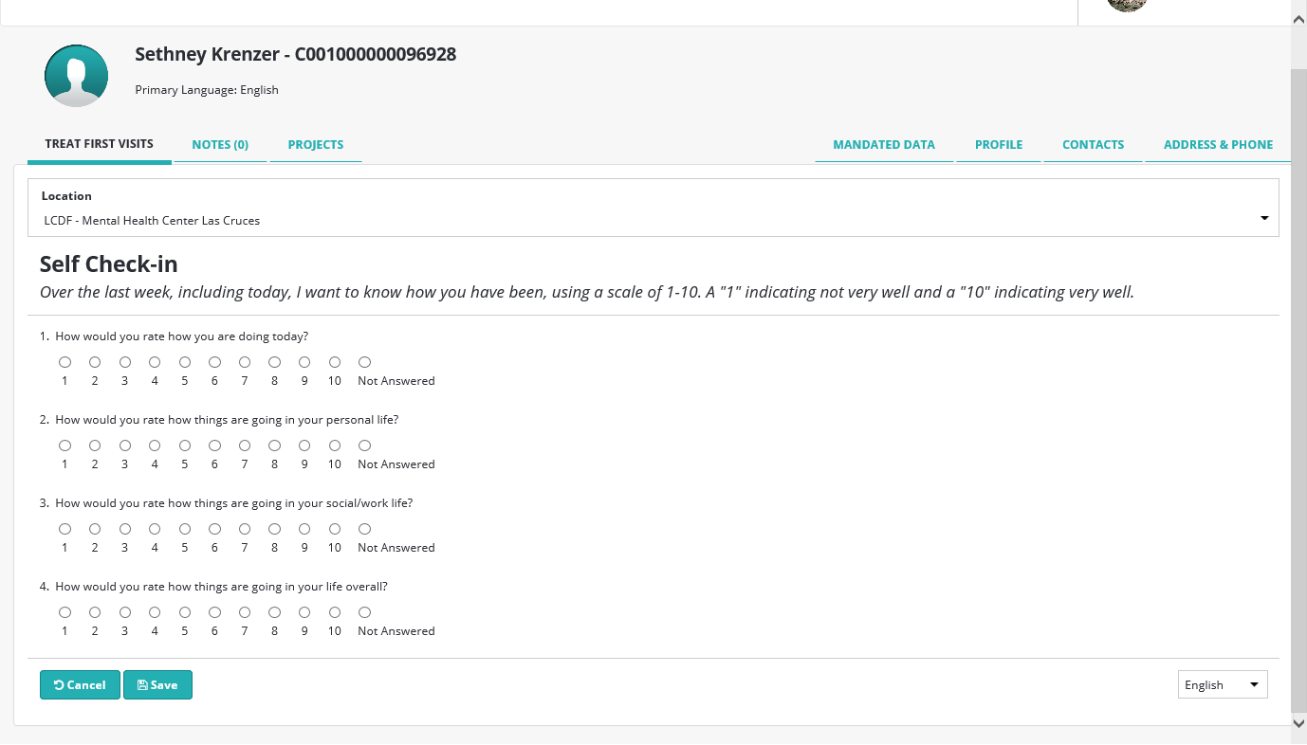

Slide 26
Session Check-in
After you have selected save in the Self Check-in section it will bring you back to the Treat First Visit tab with new buttons.
Select Session Check-in.

Slide 27
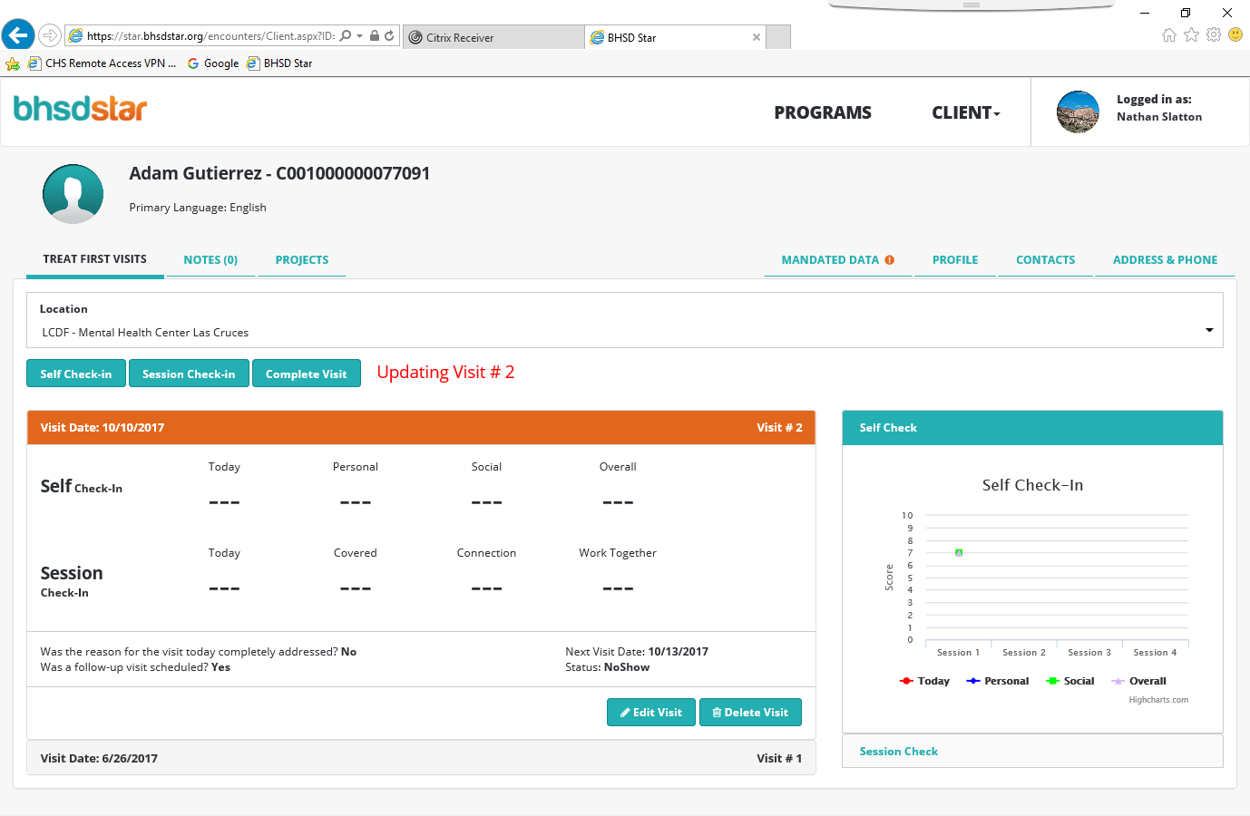

Slide 28
Session Check-in
The next slide is an example of the Session check-in portion of the Self Check-in/ Session check-in sheet that clients will NEED to do EVERY Treat First appointment.

Slide 29
This should be filled out at the end of the appointment.

Slide 30
Session Check-in cont.
The next slide is what you will see when you select Session Check-in.
This is an example of the information that BHSD Star will need from the Session Check-in sheet that the client filled out, as you can see it is the same information.
After you have filled it out select Save.

Slide 31
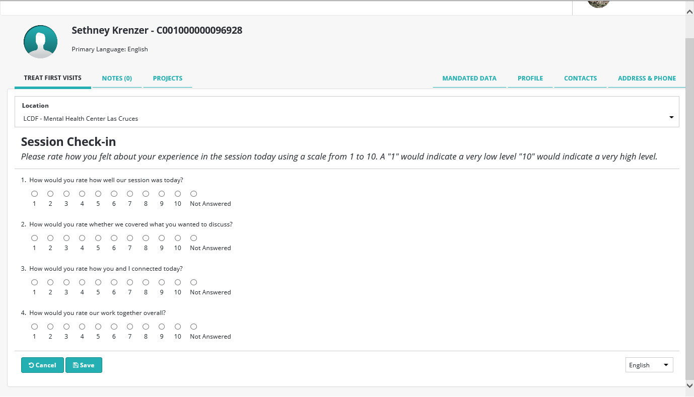

Slide 32
Complete Visit
After you have saved it will take you back to the Treat First Visit screen.
Select Complete Visit.

Slide 34
Complete Visit
The next slide is an example of the Complete Visit screen.
Was the reason for the visit completely addressed?
No, until their 4th visit then yes.
Visit date:
The date of the visit you are completing.
Was another visit scheduled?
Yes, until their 4th visit then no.
If yes, when is the appointment?
Enter in the client’s next visit date.

Slide 35
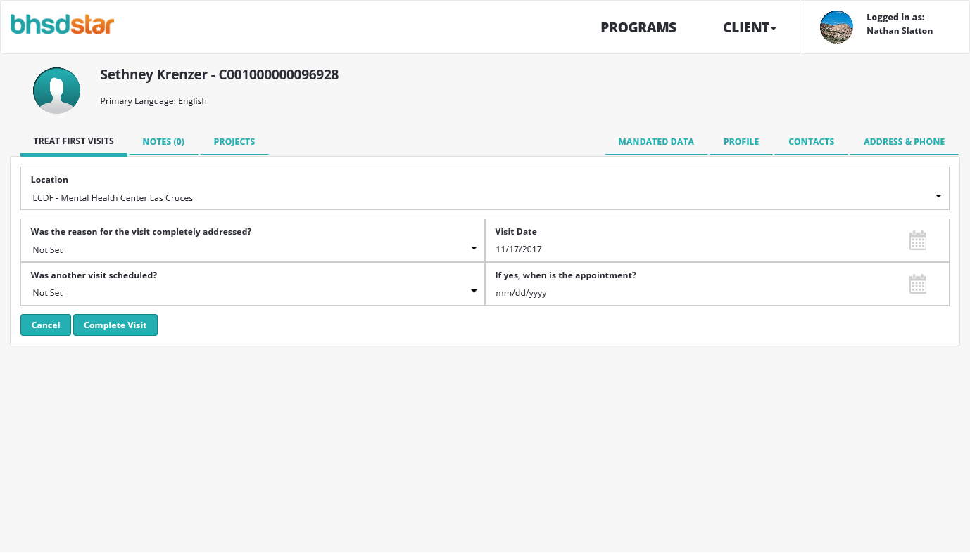

Slide 36
TREAT FIRST VISIT SUMMARY
The Treat First Visit Summary will be done after every Registration/ Update
Contains:
Document Generated on (The date the Registration/ Update was entered into BHSD STAR)
Client MRN (Chart Number)
Date of Visit (When the summary sheet was based upon)
Visit number (What visit number they are on)
Self Check-in Survey (What was put on the Self Check-In Portion)
Session Check-In (What was put on the Session Check-In Portion)
Scheduled date of follow-up visit ( When the next appt. is)

Slide 38
Time
BHSD STAR
It is policy for us to have BHSD STAR Registration done within 48 hrs. after an appt.
It is policy for us to have BHSD Star Treat First appt. updates done before the client’s next appt.

